Slide 1
School of Sanctuary – Information Session
Follow us on @SchoolCic
Notes:
Master CPD Slide 1 Updated January 2022
Register – Record all attendees on the Spreadsheet from AH. (Return within 2 days). The attendance record must be matched against participants attending and against the chat.
Welcome
Introduce self
Housekeeping what to expect in follow up / Leading onto Online etiquette
If you need an introduction to the Virtual School – Use this video
https://youtu.be/_o9kKayoNWo
Remember to play the video you need to have shared sound as well as your screen!
Introduction – Who are you? What is your role in VS?
We are transforming the way we work with families, creating new teams and increasing the mix of skills within our services.
We’ve been looking at the things that are vital for our children and the ways of working that can make the biggest difference for families. We've pinned down the Norfolk way of working – the way we approach practice and leadership in our county, and how we can ensure consistently good services for our families. This is outlined in our Vital Signs for Children vision below:
Norfolk's vital signs for children, signs of safety, well-being & success
These are the Vital Signs we want to ensure children's happiness and health.
We believe it is vital that children:
Are resilient and able to learn
Build positive, long lasting relationships
Receive family-based care
Outcome focused We do whatever it takes to achieve the best outcome for children, young people and families.
Relationship based We work to build consistent and trusted relationship with children, young people and families.
Strengths orientated We identify the strengths of children, young people and families and build on them to create positive change.
Whole family We think about family, in the widest sense in all the work we do.
Whole system We work in partnership to get the right support for children, young people and families regardless of organisational boundaries
Norfolk’s Children and Young People’s Strategic Alliance, which is made up of representatives from Children’s Services, health, police, education, family groups and the voluntary sector, has signed up to the vision, in the belief that everyone in our county has a role to play in making Norfolk the very best place to grow up.
FLOURISH is based on eight fundamental principles, with each letter representing one of the core aspects of what is needed to have a happy and fulfilling childhood.
• Family and friends - Children and young people are safe, connected and supported through positive relationships and networks
• Learning - Children and young people are achieving their full potential and developing skills which prepare them for life 2
• Opportunity - Children and young people develop as well-rounded individuals through access to a wide range of opportunities which nurture their interests and talents
• Understood - Children and young people feel listened to, understood and part of decision-making processes
• Resilience - Children and young people have the confidence and skills to make their own decisions and take on life’s challenges
• Individual - Children and young people are respected as individuals, confident in their own identity and appreciate and value their own and others’ uniqueness • Safe and secure - Children and young people are supported to understand risk and make safe decisions by the actions that adults and children and young people themselves take to keep them safe and secure
• Healthy - Children and young people have the support, knowledge and opportunity to lead their happiest and healthiest lives.

Slide 2
Check your microphone is off.
Check your camera is switched on.
Online Etiquette
We are using technology today so it may freeze but rejoin us as soon as you can.
We are not recording this session.
Use the chat facility to ask questions
Questions will be read and answered after each section of the session. There will also be time for further questions at the end
Remember everyone can read your responses in the chat.
Notes:
MASTER SLIDE 2
We will be asking you to join in conversation throughout the session, so we will prompt you to turn your microphone back on!
In the chat place your thoughts, responses to (Specific warm up question)
Ask a question and engage with the response. This helps people to know we value what they say.
You may need to direct newcomers to Teams how to find the chat bubble on the toolbar!
ASK everyone to post in the chat their name and school setting to enable us to gather the correct spelling for their Completion Certificate and to ensure we send it to the correct email contact.

Slide 3
Presenters
Jake Rose-Brown
Norfolk Schools of Sanctuary Lead
Teacher & DEI Lead, Avenue Junior School
Tanya Ingram
NCC School of Sanctuary Co-ordinator
EAL/EDC Team Manager

Slide 4
2. Hear the experiences of two schools in Norfolk which have achieved the Award
Learning Outcomes
1. Find out about the School of Sanctuary Award and the benefits of your school achieving it.
3. Learn about the application process and support available for your school with this
4. Have your questions answered
Notes:
Master CPD Slide 3 These must be the outcomes as advertised on SLA plus a a maximum of 4 bullet points to summarise the session

Slide 5
Follow us on Twitter
@NorwichSOS
Information
Join our Facebook group: Norfolk Schools of Sanctuary
Contact us for support: info@norfolksos.co.uk
or
Tanya.ingram@norfolk.gov.uk
Check our website for more information: www.norfolksos.co.uk
Join the NSoS Google Group
Tanya.ingram@norfolk.gov.uk

Slide 6
Introduction

Slide 7
There are more than 320+
Schools of Sanctuary in the UK
A School of Sanctuary is a safe and welcoming place, especially for those seeking sanctuary.
It is a school that is proud to be a place of safety, hospitality and inclusion for all.

Slide 8
City of Sanctuary is a grassroots movement committed to building a culture of hospitality and welcome, especially for refugees seeking sanctuary from war and persecution.
Notes:
My journey to CoS. Context. Places of sanctuary in N – UEA, arts centre, Unitarian Chapel, bar, restaurant, Norfolk Knitters, Also open to Norfolk.

Slide 9
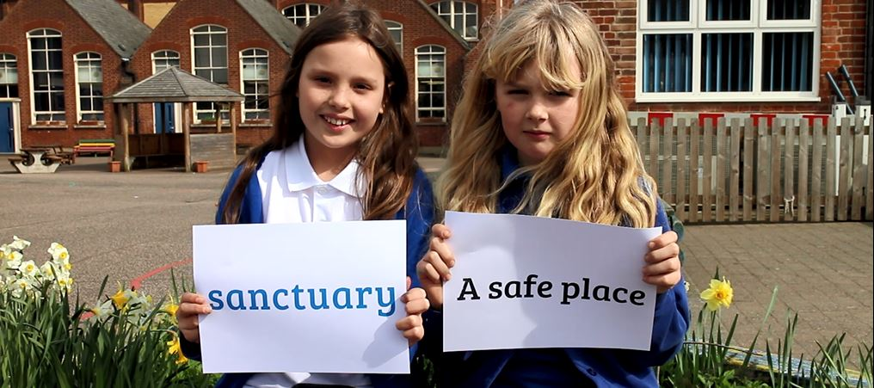
Contribute significant curriculum opportunities for the effective leadership of Social, Moral, Spiritual and Cultural Development, and to build understanding of British Values
Provide learning opportunities around global issues, human rights, migration, social justice, diversity and interdependence
Improve EAL provision and practice
Why become a School of Sanctuary?
Help build a school culture that is inclusive, anti-racist, trauma-informed and supportive, and one in which intolerance, hate speech and bullying are all reduced
Help meet the school’s obligations under the Equality Act 2010
Meaningful opportunities to improve student voice and promote active citizenship.
Engage families and strengthen the school’s role in the community
Support a school's ability to fulfil the Prevent duty - to prevent people from being drawn into terrorism, including far-right extremism that promotes an anti-refugee agenda
Schools of Sanctuary is not just about asylum seekers and refugees. Schools of Sanctuary is for all schools!

Slide 10
1. Recognise good practice
AUDIT
2. Identify areas to develop
AUDIT
3. Carry out your ideas
IMPLEMENT
4. Consider the impact APPLY
5. Plan your next steps
APPLY
THE AWARD PROCESS

Slide 11
Experiences from Norfolk Schools of Sanctuary

Slide 12
There are currently 17 Schools of Sanctuary in Norfolk
170+ Norfolk schools participated in A Day of Welcome in June 2022

Slide 13
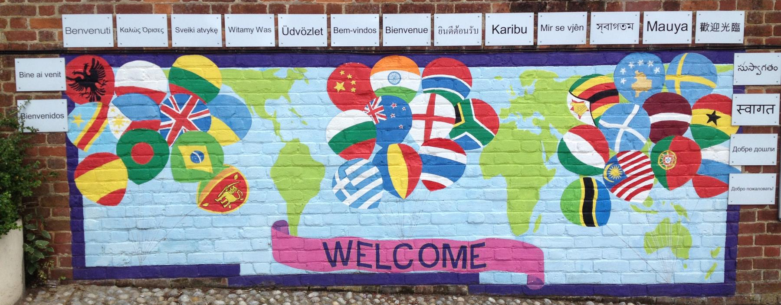
Will Turnpenny Magdalen Gates Primary School
Tom Pritchard
Notre Dame High School

Slide 14
To build understanding of the experiences of forcibly displaced people and combat stereotypes and misconceptions about refugees and asylum seekers
To engage with Norfolk’s rich history as a place of sanctuary
To support refugee communities and the organisations that serve them
To facilitate and share good practice across the wider educational community within and beyond the county
Notes:
Third one inspiration for Norfolk Welcomes

Slide 15
SCHOOLS OF SANCTUARY PRINCIPLES & MINIMUM CRITERIA
There are 8 minimum criteria that all schools must fulfil as a minimum if they are to considered a School of Sanctuary.
Read each criteria and decide which principle you think it comes under: learn, embed or share. Share your thoughts in the chat box.
Evidence of refugee/asylum/migration learning activities are included into school life and at least one example in the curriculum, across the key stages.
Notes:
Activity -

Slide 16
SCHOOLS OF SANCTUARY PRINCIPLES & MINIMUM CRITERIA
There are 8 minimum criteria that all schools must fulfil as a minimum if they are to considered a School of Sanctuary.
Read each criteria and decide which principle you think it comes under: learn, embed or share. Share your thoughts in the chat box.
Commitment to on-going engagement with the Schools of Sanctuary stream. This may include sharing resources, ideas and achievements via the school’s website or the national City of Sanctuary website, and/or with other local/regional schools.
Notes:
Activity -

Slide 17
SCHOOLS OF SANCTUARY PRINCIPLES & MINIMUM CRITERIA
There are 8 minimum criteria that all schools must fulfil as a minimum if they are to considered a School of Sanctuary.
Read each criteria and decide which principle you think it comes under: learn, embed or share. Share your thoughts in the chat box.
Commitment to supporting age-appropriate active pupil voice on sanctuary and welcome/welcoming activities in the school. For example, this might mean ensuring that your School Council or other student-led groups are actively involved in the process of working towards recognition.
Notes:
Activity -

Slide 18
SCHOOLS OF SANCTUARY PRINCIPLES & MINIMUM CRITERIA
There are 8 minimum criteria that all schools must fulfil as a minimum if they are to considered a School of Sanctuary.
Read each criteria and decide which principle you think it comes under: learn, embed or share. Share your thoughts in the chat box.
The School must demonstrate how it has embedded the concept of welcome and inclusion in the school. This should show how the school will continue to develop and sustain a culture of welcome beyond the award
Notes:
Activity -

Slide 19
SCHOOLS OF SANCTUARY PRINCIPLES & MINIMUM CRITERIA
There are 8 minimum criteria that all schools must fulfil as a minimum if they are to considered a School of Sanctuary.
Read each criteria and decide which principle you think it comes under: learn, embed or share. Share your thoughts in the chat box.
Training and education opportunities are provided for school staff & management on refugee, asylum and migration issues
Notes:
Activity -

Slide 20
SCHOOLS OF SANCTUARY PRINCIPLES & MINIMUM CRITERIA
There are 8 minimum criteria that all schools must fulfil as a minimum if they are to considered a School of Sanctuary.
Read each criteria and decide which principle you think it comes under: learn, embed or share. Share your thoughts in the chat box.
Recognition of and participation in the annual Refugee Week, A Day of Welcome and/or other annual/regular celebratory events which highlight the contribution of people seeking sanctuary and migrants to the UK.
Notes:
Activity -

Slide 21
SCHOOLS OF SANCTUARY PRINCIPLES & MINIMUM CRITERIA
There are 8 minimum criteria that all schools must fulfil as a minimum if they are to considered a School of Sanctuary.
Read each criteria and decide which principle you think it comes under: learn, embed or share. Share your thoughts in the chat box.
The school publicly highlights its activities in support of welcome and inclusion. This can include social media/website posts, school newsletter updates or attending regional activities or meetings.
Notes:
Activity -

Slide 22
SCHOOLS OF SANCTUARY PRINCIPLES & MINIMUM CRITERIA
There are 8 minimum criteria that all schools must fulfil as a minimum if they are to considered a School of Sanctuary.
Read each criteria and decide which principle you think it comes under: learn, embed or share. Share your thoughts in the chat box.
A public commitment to the City of Sanctuary vision of welcome, including the endorsement of the City of Sanctuary charter
Notes:
Activity -

Slide 23
LEARN
Training and education opportunities are provided for school staff & management on refugee, asylum and migration issues
EMBED
The School must demonstrate how it has embedded the concept of welcome and inclusion in the school. This should show how the school will continue to develop and sustain a culture of welcome beyond the award
SHARE
A public commitment to the City of Sanctuary vision of welcome, including the endorsement of the City of Sanctuary charter
Evidence of refugee/asylum/migration learning activities are included into school life and at least one example in the curriculum, across the key stages.
Commitment to supporting age-appropriate active pupil voice on sanctuary and welcome/welcoming activities in the school. For example, this might mean ensuring that your School Council or other student-led groups are actively involved in the process of working towards recognition.
Commitment to on-going engagement with the Schools of Sanctuary stream. This may include sharing resources, ideas and achievements via the school’s website or the national City of Sanctuary website, and/or with other local/regional schools.
Recognition of and participation in the annual Refugee Week, A Day of Welcome and/or other annual/regular celebratory events which highlight the contribution of people seeking sanctuary and migrants to the UK. More information about Refugee Week events can be found here.
The school publicly highlights its activities in support of welcome and inclusion. This can include social media/website posts, school newsletter updates or attending regional activities or meetings.
MINIMUM CRITERIA
Notes:
Activity -

Slide 24
What might this look like in my school?
LEARN
Staff training with New Routes
School trip to Strangers’ Hall
Day off curriculum for A Day of Welcome
Seek approval for SoS from governors
Welcome cards for Syria, Afghan, Ukrainian and Asylum seeker families resettling in Norfolk
Classes named after famous refugees
Norfolk Record Office workshop on Norfolk’s history as a place of sanctuary
Assemblies on topic
Here are some examples from Schools of Sanctuary in Norfolk
Notes:
animate

Slide 25
What might this look like in my school?
LEARN
Staff training with New Routes
School trip to Strangers’ Hall
EMBED
Mentor local refugees into employment
Pupil voice to shape SoS in your setting – School Council
Day off curriculum for A Day of Welcome
Seek approval for SoS from governors
Welcome cards for Syria, Afghan, Ukrainian and Asylum seeker families resettling in Norfolk
Classes named after famous refugees
Norfolk Record Office workshop on Norfolk’s history as a place of sanctuary
Assemblies on topic
Fundraise for Welcome Wheels
Embedd SoS principles across the curriculum
Include A Day of Welcome & Refugee Week in the school calendar
Local history study – Norfolk’s migration history
SoS mural/art project
Use books to explore migration and displacement
Here are some examples from Schools of Sanctuary in Norfolk
Notes:
animate

Slide 26
What might this look like in my school?
LEARN
Staff training with New Routes
School trip to Strangers’ Hall
EMBED
Mentor local refugees into employment
Pupil voice to shape SoS in your setting – School Council
SHARE
Share with parents/carers via social media and school newsletters
Present at our annual Teach Meet
Day off curriculum for A Day of Welcome
Seek approval for SoS from governors
Welcome cards for Syria, Afghan, Ukrainian and Asylum seeker families resettling in Norfolk
Classes named after famous refugees
Norfolk Record Office workshop on Norfolk’s history as a place of sanctuary
Assemblies on topic
Fundraise for Welcome Wheels
Embedd SoS principles across the curriculum
Include A Day of Welcome & Refugee Week in the school calendar
Local history study – Norfolk’s migration history
SoS mural/art project
Support other schools to become SoS
Spotlight SoS on your school website
Support local campaigns and initiatives to help refugees & asylum seekers
Share good practice at the annual SoS lecture for PGCE students at UEA
Use books to explore migration and displacement
Contribute to SoS CPD
Here are some examples from Schools of Sanctuary in Norfolk
Notes:
animate

Slide 27
Notes:
https://youtu.be/4FliySPyw_I

Slide 28
https://www.norfolksos.co.uk/a-day-of-welcome-2022
Register to participate
Download the flyer for A Day of Welcome
Review the resources for 2021
Our historical inspiration for 2022 will be the Kindertransport
OUR AIMS
Build understanding of the experiences and contributions of refugees and asylum seekers.
Uncover and celebrate little-known stories of refugee migration.
Signpost Refugee Week events which pupils, families and staff may wish to participate in.
Our wide range of resources are designed to help introduce refugee migration to pupils and to explore the topic across Key Stages 1 to 4.
* Free stickers available for your pupils * Norfolk specific resources available
* Fundraise for New Routes initiative – Welcome Wheels

Slide 29
IS ORGANISED BY
---- IN ASSOCIATION WITH ----
LOCAL PARTNERS

Slide 30
Your questions

Slide 31
Evaluation
Learning Outcomes
1. Find out about the School of Sanctuary Award and the benefits of your school achieving it.
2. Hear the experiences of two school in Norfolk who have achieved the SoS Award
Using this link to the MS Form:
Please respond to the questions within a week!
3. Learn about the application process and support for your school with this
Notes:
Master CPD Slide 6 Evaluation
Long MS Form Link into the notes INSERT the short link into the slide / chat! (Less off putting!) MAKE SURE you have your link from Anna.
The outcomes must be the same as Slide 3!

Slide 32
Future EAL training
EAL Secondary Network
3 virtual meetings
1 per term
£75
E-learning EAL course
Classroom Strategies for teachers – Primary
Online rolling enrolment
£85
EAL Primary Teaching Assistants Course
8 sessions
Virtual and in person
£600
EAL Co-ordinators Course -Secondary
EAL Co-ordinators Course
Secondary
3 virtual modules - Aut. term
£175
EAL Co-ordinators Course Primary
3 virtual modules – Aut term
£150
EAL Early Years Network
3 virtual meetings
1 per term
£25
Early Years Introduction to EAL / EAL & EAL Assessment courses
Early years training - Schools (norfolk.gov.uk)
Funded
EAL Primary Network
3 virtual meetings
1 per term
£75
EAL / SEN course
Distinguishing the Difference Primary / Secondary
In person
£150

Slide 33
MS form to express interest
https://forms.office.com/r/tKTqfpti4S

